Slide 1


Superstore Online Retail Sales Analysis (2016-2019) Olumide Durojaiye

Slide 2

Introduction
Superstore is a online retail chain store business located in Canada. The company sells Furniture, Office supplies and Technology products and their customers are the general Consumer, Corporate and Homes offices. In this case study, we have an exploratory data set that contains sales, profits, geographical information, customer details, shipping costs and product details. Our task is to analyse the sales data in order to identify opportunities for maximizing profit and also to review loss making areas where improvements can be made.

Slide 3

Business Understanding
Superstore has online retail business with 3 segments- Technology, Supplies and Furniture
The customers are of three types- consumers, Corporate and Home office
The store locations are in 3 regions namely – Western Canada, Central Canada and Atlantic.
The number of stores in the various regions are as follows:
Atlantic region- 3
Central Canada region- 30
Western Canada- 13
The shipping mode used by the store includes First Class, same day, Second Class and Regular shipping.
Continued….

Slide 4

Scope of Project
Scope of works includes reviewing:
profit optimisation and sales performance
loss making products
We will also look at business questions and analyze the dataset to provide solutions and recommendations using data analytics models

Slide 5

Source - https://www.kaggle.com/datasets/shrutigupta2495/the-real-canadian-superstore-dataset

Slide 6

Data Cleaning & Preparation
* Performed data cleaning in excel for blanks, null values, redundant columns and splitting the Order Date
* Imported data to SQL and verified data set in SQL
* Created Dimensions and Facts Table in Visual Studio 2019- SQL Integration (SSIS)
* Built solutions in Visual Studio 2019- Analysis (SSAS)
* Built solution in SQL Analysis (OLAP)

Slide 7
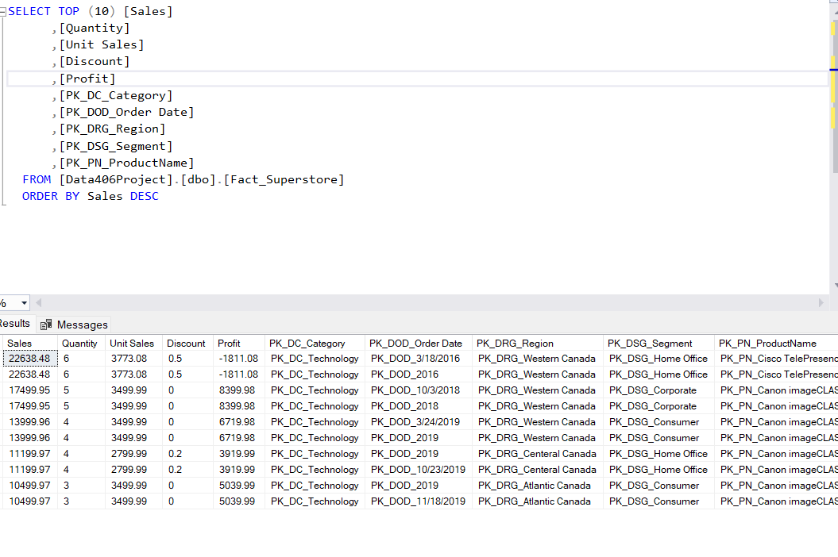
SQL Query showing sales for the top 10 products by segment , category and region .

Slide 8
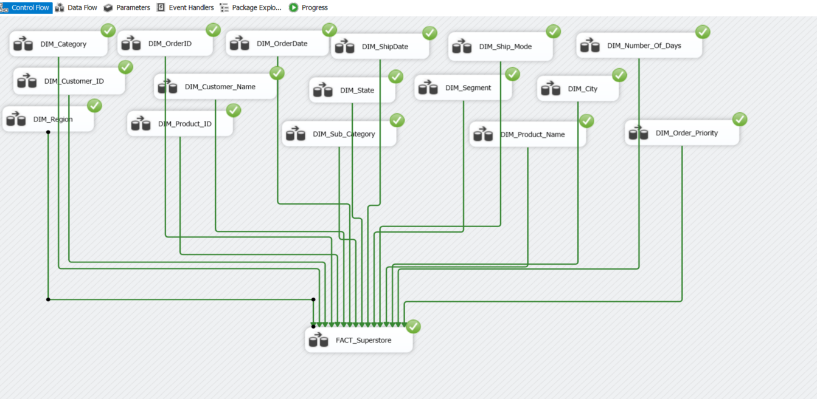
Multidimensional and Fact Table-SSIS

Slide 9
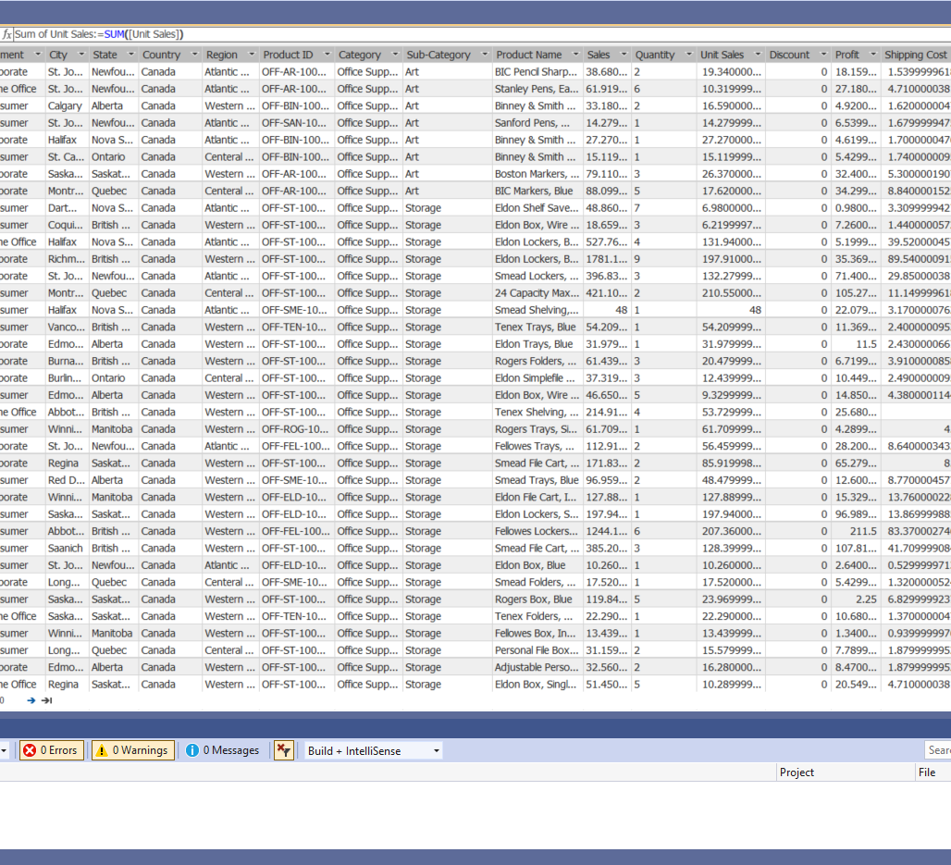
Dimension Modelling and Solution-SSAS

Slide 10
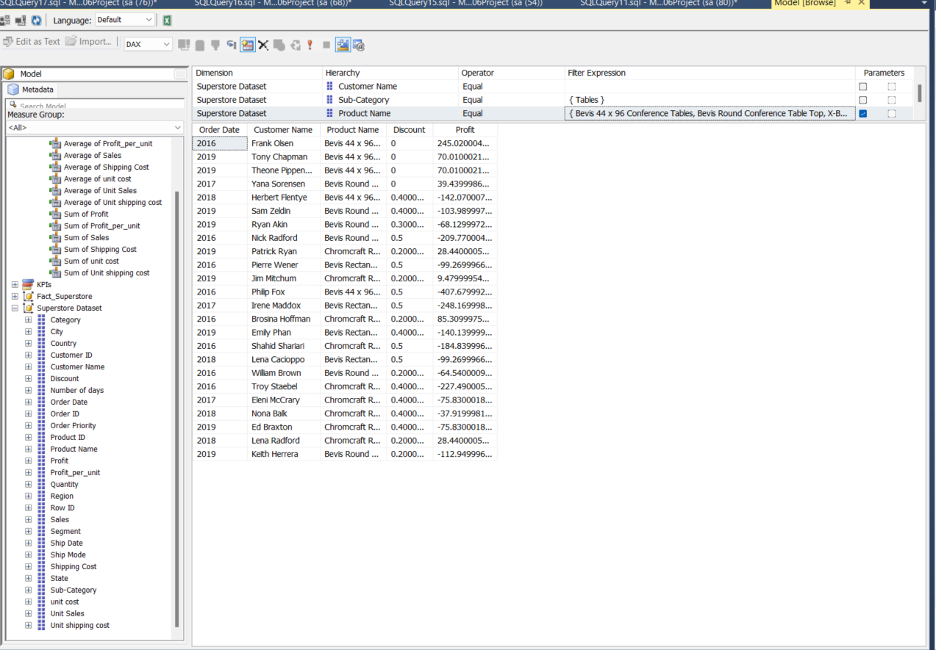
SQL Analysis showing the SSAS modelling

Slide 11
5W 1H Analysis 1 – Who
# | Question | Answer
Q1.1 | Who is involved? | Business owners, Employees, Customers, Vendors, Logistics companies
Q1.2 | Who is affected? | Business owners, Employees, Customers, Vendors, Logistics companies
Q1.3 | Who will benefit? | Business owners
Q1.4 | Who will be harmed? | N/A
Notes:
The questions on this slide are sourced from this article:
https://premium.wpmudev.org/blog/a-simple-sure-fire-way-to-create-great-content-the-5-w-the-h/
Who is involved?
Who is affected?
Who will benefit?
Who will be harmed?

Slide 12
5W 1H Analysis 1 – Who
# | Question | Answer
Q2.1 | What is your topic narrowed down in a simple phrase/sentence? | Increasing profitability, Minimizing losses and Enhancing customer experience.
Q2.2 | What does your topic involve? (i.e. What are the different parts to it?) | Comparing the performance of the store for different segments and products in different cities. We also analyzed customer buying patterns
Q2.3 | What is it similar to / different from? | N/A
Q2.4 | What might be affected/changed by your topic? | The overall store performance in terms of business and growth and great customer experience
Notes:
The questions on this slide are sourced from this article:
https://premium.wpmudev.org/blog/a-simple-sure-fire-way-to-create-great-content-the-5-w-the-h/
Who is involved?
Who is affected?
Who will benefit?
Who will be harmed?

Slide 13
5W 1H Analysis 3 –When
# | Question | Answer
Q3.1 | When does this take place? When did this take place? When will it take place? When should this take place? | The dataset is for the period between 2016 and 2019.
Q3.2 | Does when this takes place affect the topic? | N/A
Notes:
The questions on this slide are sourced from this article:
https://premium.wpmudev.org/blog/a-simple-sure-fire-way-to-create-great-content-the-5-w-the-h/
When does this take place? When did this take place? When will it take place? When should this take place?
Does when this takes place affect the topic?

Slide 14

5W 1H Analysis 4 – Where
# | Question | Answer
Q4.1 | Where does this take place? (Where did it …. Where will it … Where should it ….?) | This took place in Canada across different provinces.
Notes:
The questions on this slide are sourced from this article:
https://premium.wpmudev.org/blog/a-simple-sure-fire-way-to-create-great-content-the-5-w-the-h/
Where does this take place? (Where did it …. Where will it … Where should it ….?)
Does it matter where it takes place? Is it affected by location?

Slide 15
5W 1H Analysis 5 – Why
# | Question | Answer
Q5.1 | Why is this topic important? Why does it matter? | It will help drive informed business decisions. It explores how the business can increase their overall performance to boost growth.
Q5.2 | Why do certain things happen? (What are some causes and effects within the topic?) | The company data shows there has been some losses. Hence, we seek to discover those areas of losses and offer recommendations that could be beneficial to the company in general.
Notes:
The questions on this slide are sourced from this article:
https://premium.wpmudev.org/blog/a-simple-sure-fire-way-to-create-great-content-the-5-w-the-h/
Why is this topic important? Why does it matter?
Why do certain things happen? (What are some causes and effects within the topic?)

Slide 16
5W 1H Analysis 6 – How
# | Question | Answer
Q6.1 | How does this topic work? How does it function? How does it do what it does? | By studying the trends and buying patterns of online shoppers, meaningful insights will be extracted, and Superstore can plan better as well as efficiently catering for the online customer demands.
Q6.2 | How did it come to be? | A need for business growth: to reduce losses, increase profitability and enhance customer experience
Q6.3 | How are those involved affected? | The analysis will be beneficial to all stakeholders involved with the store.
Notes:
The questions on this slide are sourced from this article:
https://premium.wpmudev.org/blog/a-simple-sure-fire-way-to-create-great-content-the-5-w-the-h/
How does this topic work? How does it function? How does it do what it does?
How did it come to be?
How are those involved affected?

Slide 17

2 – Data Understanding – High Level

Slide 18

Data Modeling – Conceptual Model
Segments
Consumer
Home office
Corporate
Product Category
Office Supplies-, storage
Technology-
Furniture- Furnishings, Table, Chairs
Sub-Category
Paper, Art, Labels, Binders, Bookcases Fasteners, Envelopes, Supplies, Storage Appliances, Copiers, Machines, Accessories, Phones, Furnishings, Table, Chairs
Regions and Cities
* Western Canada (Manitoba, Alberta, British Columbia, Saskatchewan)
* Atlantic (NewfoundLand, Nova Scotia)
* Central Canada (Ontario, Quebec)
Recommendations
Review discount policy of some stores- Keep discounts to between 10 -30%.
Discontinue loss making products from some of the loss making stores.
Have products available in the city warehouses or nearby cities to avoid shipping delay and cost.
Bundle products to spread shipping cost and optimise sales /profit
Adopt a customer segmentation for a more strategic reach
Causes
Superstore Online sales performance (2016-2019)
Key Players
Business Owners/Managers,
Employees
Customers
Vendors
Shipping /Logistics Companies
Analysis
- Improving Superstore sales performance
- Increase customer base
-Maximise profit margin
- Reduce cost and optimize options to improve profitability

Slide 19
Data Dictionary
No | Topic | Definition
1 | Association Mining | It finds interesting associations and relationships among large sets of data items
2 | Profit Margin | The amount by which revenue from sales exceeds cost of a business. It is calculated by finding the profit as a percentage of the revenue.
3 | Segments | Operating business areas
4 | Discount | Percentage or dollar value of price reduction on saleable items.
5 | Profit Optimisation | Is a process that incorporates revenue and total costs into analysis to better understand the margins of business at highly detailed levels.
6 | Sales Performance | It can be measured by common metrics such as sales revenue, customer acquisition and retention rate over a period.
7 | Linear Regression | Is used to predict the value of a variable based on the value of another variable.
8 | Forecast | Sales prediction of the business over a certain time period.

Slide 20

Business Question 1- How can we reduce cost and improve profitability?
By identifying buying patterns and trends, we aim to predict customer behavior and users buying preference
Identify the weak areas of the sales departments in order to improve the sales Review loss making products.
Reviewing cost effective measures
Reviewing discounts policy and shipping strategies
Providing recommendations and solutions to improve customer experience and business profitability.

Slide 21
Visualisations

Slide 22
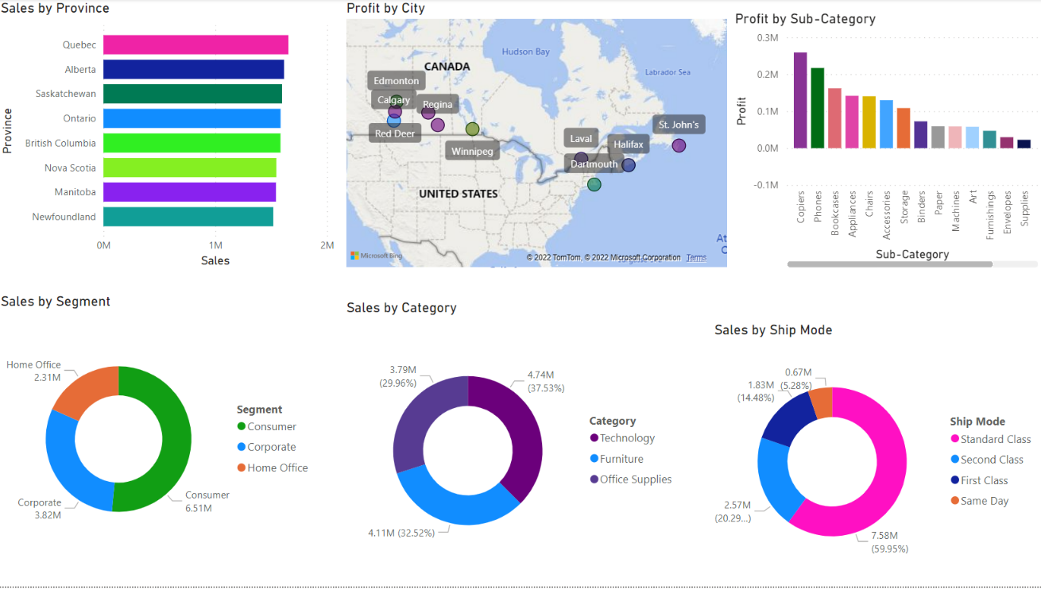
Dashboard-Superstore Performance

Slide 23
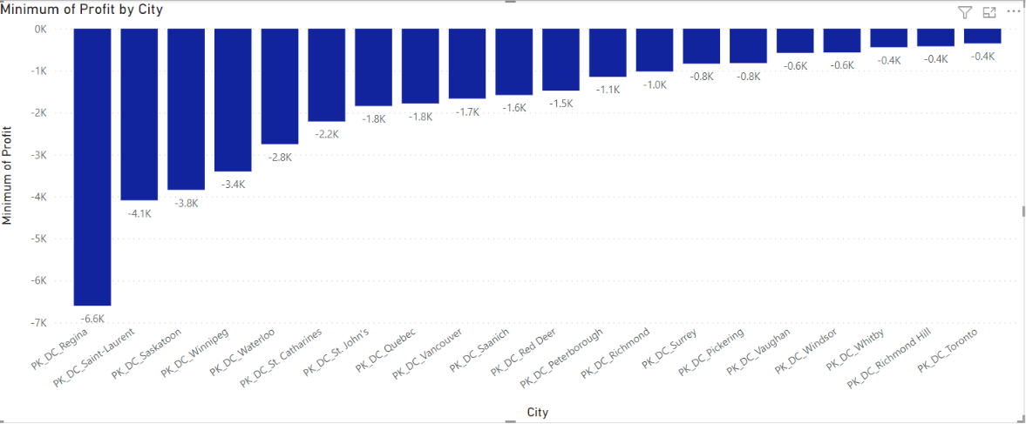
Loss by top 20 City

Slide 24
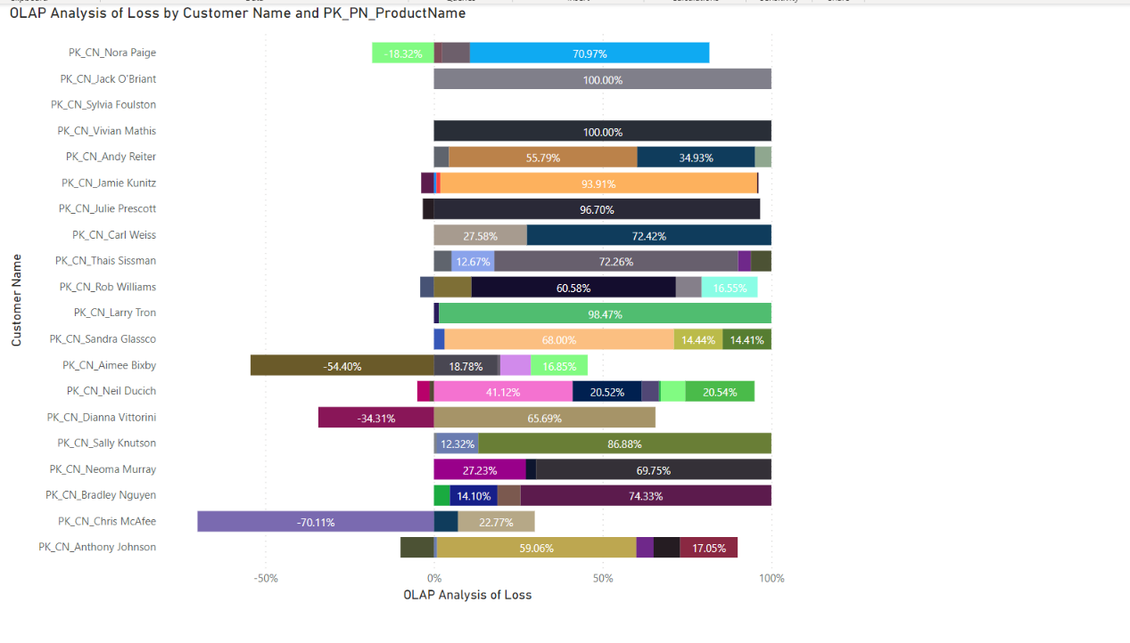
Top 20 – Loss by customers

Slide 25
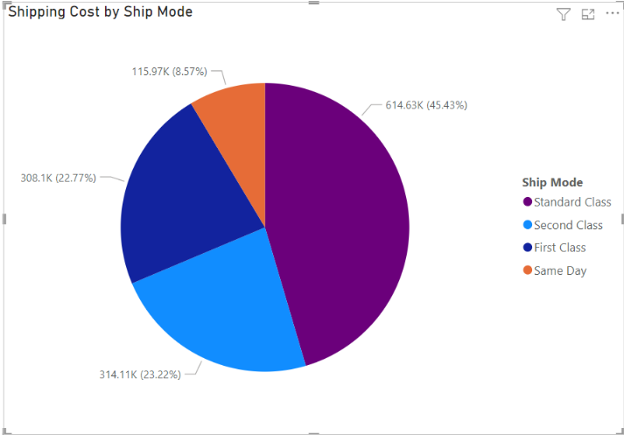
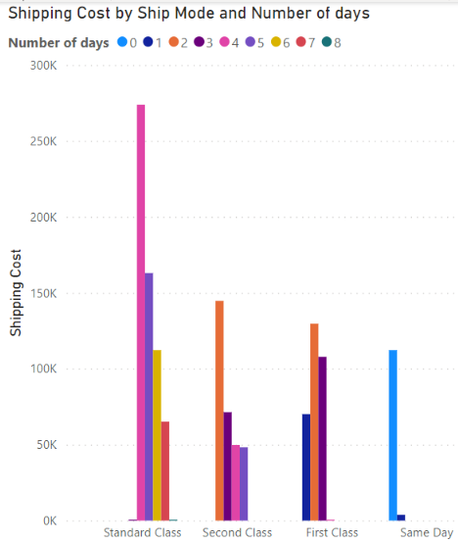
Ship mode by cost and No of days
The pie chart indicates the lower the number of days required to deliver the higher the cost of shipping.
The graph shows the cost and number of days it takes to deliver the good and the cost involved. Hence the cost of same day delivery and first class is high.

Slide 26
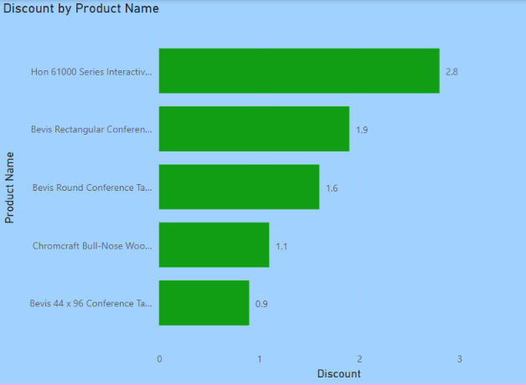
﻿ Discounts applied for loss making products At 2.80, Hon 61000 Series Interactive Training Tables had the highest Discount and was 211.11% higher than Bevis 44 x 96 Conference Tables, which had the lowest Discount at 0.90. ﻿Hon 61000 Series Interactive Training Tables accounted for 33.73% Discount. Across all 5 Product Name, Discount ranged from 0.90 to 2.80.﻿

Slide 27
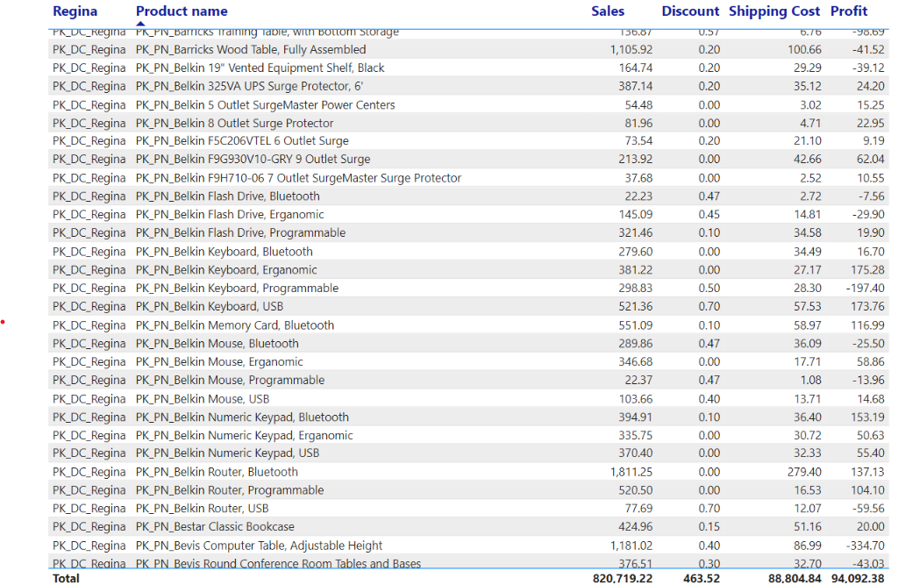
Reviewing the highest loss making City- Regina
Analysis shows- high discount rates applied to various products up to max of eighty percent for a product.
Also shows the high cost of shipping for Regina.

Slide 28
Business Question 1 -Summary of Analysis
Based on the analysis it can be inferred that the shipping cost and discount are the key factors affecting losses
There is a negative correlation between profit and discount. The higher the discount the lower the profit.
The furniture category incurs more losses than the technology and Office Supplies category. Sales also vary from low to high in this category so does profits.
On the other end of the spectrum, Machines, Fasteners, Supplies, Bookcases and Tables make close to zero margin to losses. These are products that Super Store can consider dropping from the product catalogue or increase the sale price and profit margin or bargain for a lower price from the supplier.
Discounts/markdowns – control seems to be lacking

Slide 29
Business Question 2-What store (city) and what products can help achieve business growth? What is the forecast of profit for the next 3 years?
What are the top 10 cities with the highest sales and profits.
What are the top 15 product with the highest profit.
What category and sub-category is more profitable.
In what year was the highest sales/profit made.
What is the forecast of profit for the next three years.

Slide 30
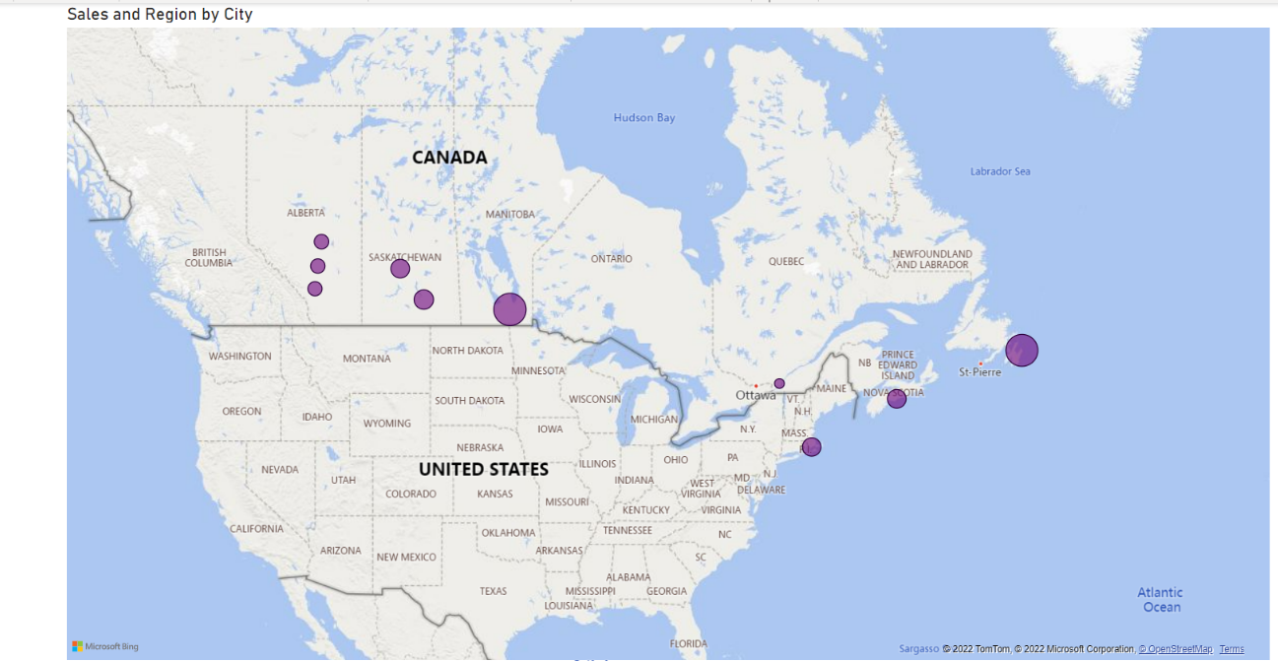
Top 10 Cities with highest Sales

Slide 31
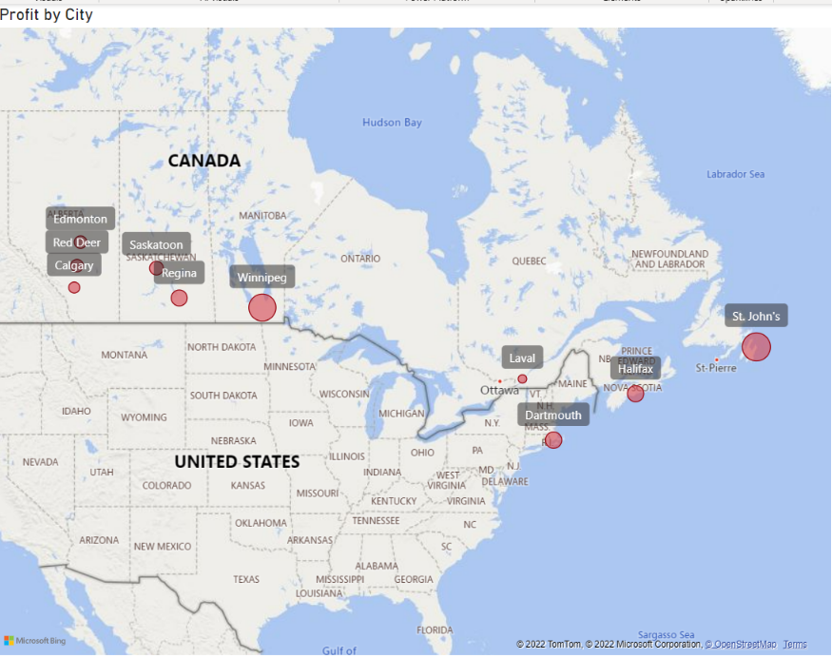
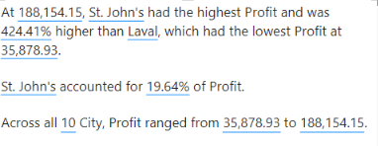
Top 10 Cities with highest Profit

Slide 32
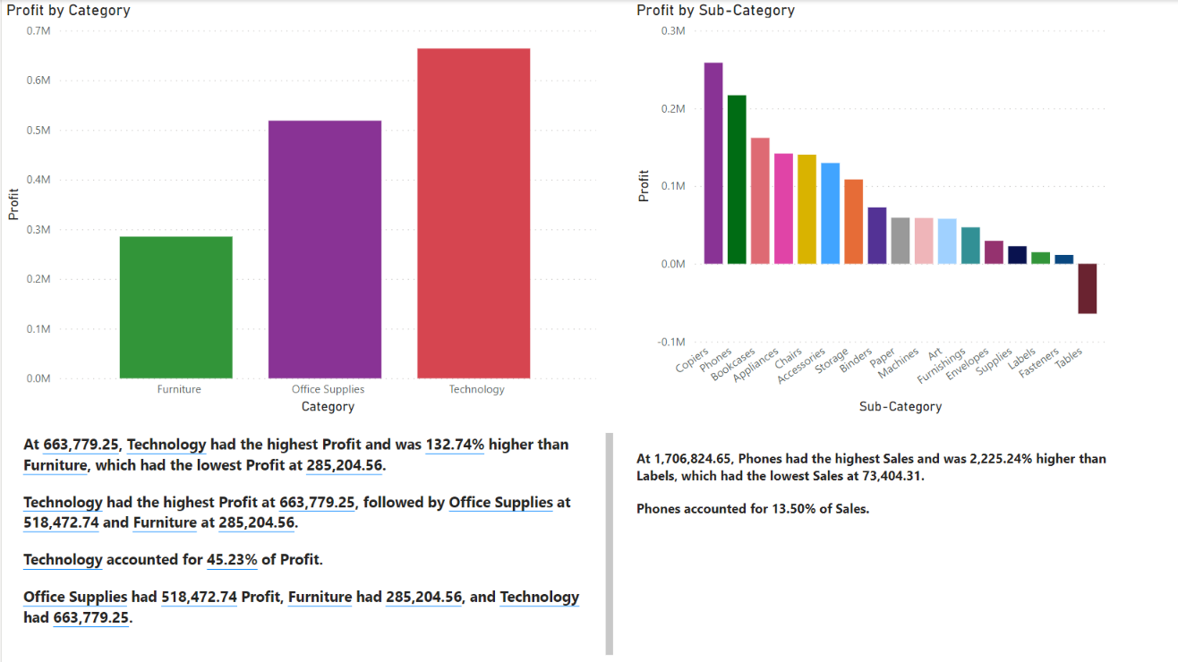
Profit by Category and Sub-category

Slide 33
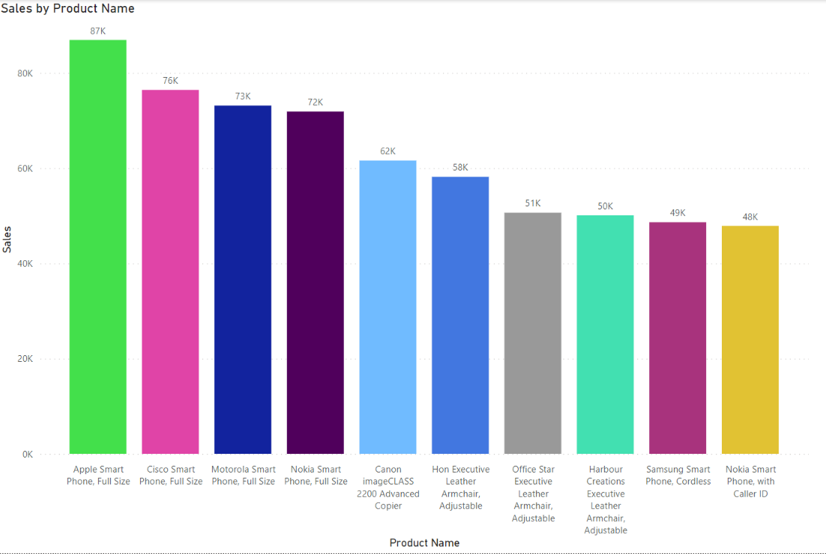
Top 10 Sales by Product name

Slide 34
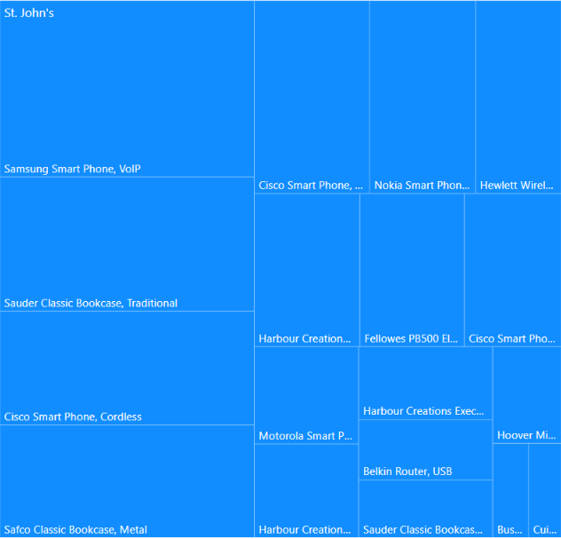
Profit City and Product Name
St. John is remote place and far away compared to other cities. Hence, it can be inferred that the need for up to date and advance technology is necessary to remain in communication with the world.

Slide 35
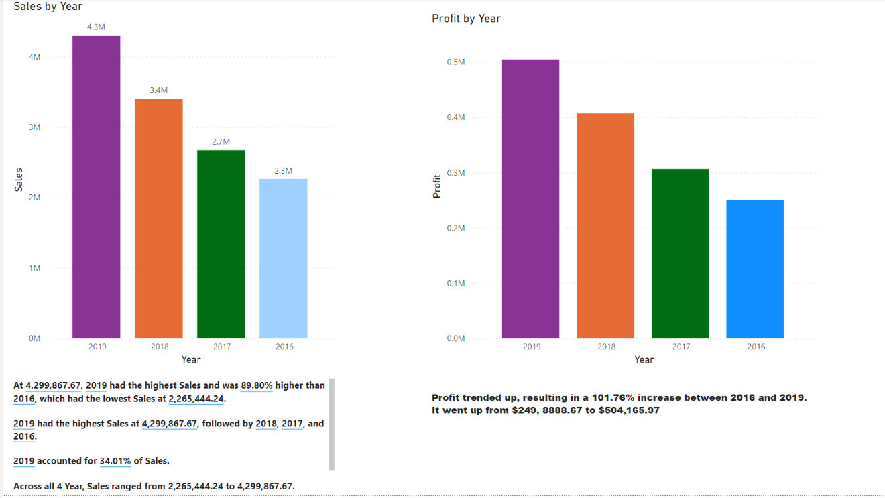
Sales and Profit by Year

Slide 36
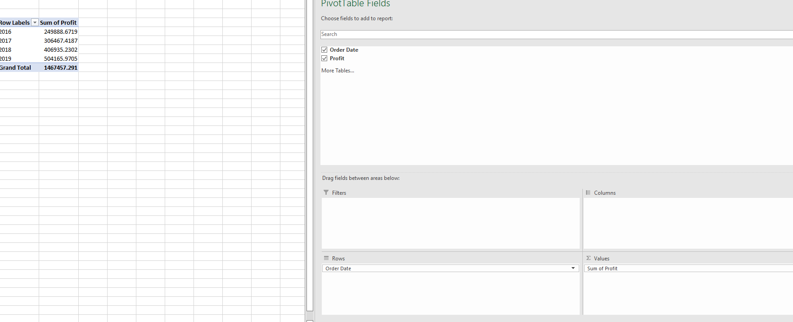
Pivot table showing profits by year (2016-2019)

Slide 37
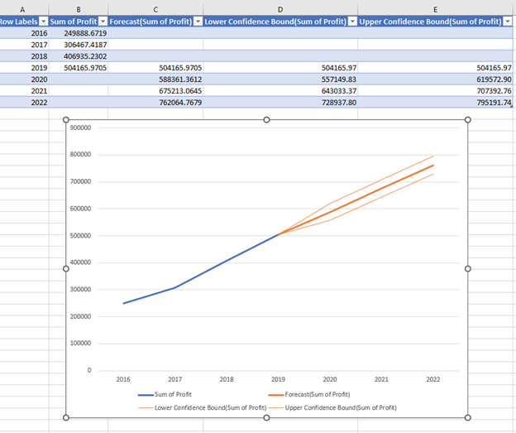
Business question- Forecast of Profit for the next 3 years showing the upper and lower confidence

Slide 38
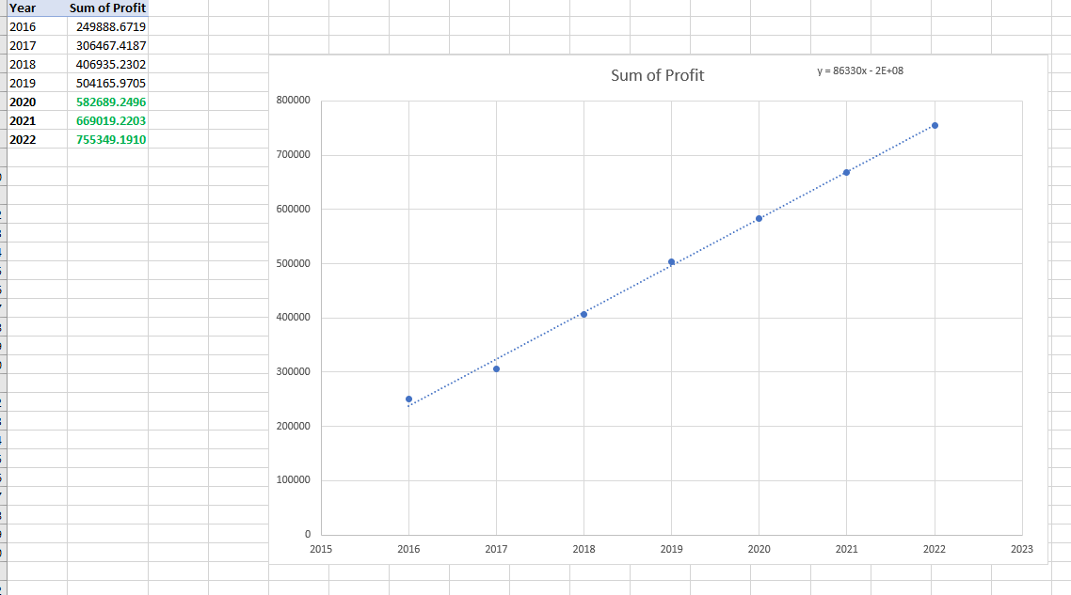
Forecast of the profit for the next 3 years(2020- 2022)

Slide 39
Summary of Analysis
From the visualizations above, it can be inferred that the superstore in St John’s, Newfoundland, is the most profitable store and the top selling product across the stores is the phones in the Technology category.
Technology category has the highest sales, then furniture and office supplies.
It is also seen that most sales have been made from the West and East regions
It is also seen the top selling products are smartphones, copiers, chairs and binders.
The analysis indicated Phones and Chairs are Top 2 best selling sub-category.
Copiers produces most profit, followed by Phones, Accessories, Papers and Binders. The sales and marketing strategy must focus on marketing these products.
Also, we can see that 2019 had the highest number of sales and profits. A forecast analysis done shows a positive slope which indicates that there will be an increase in profit over the next three years.

Slide 40
Business Question -3 How can we increase profit
What are the factors that affecting the sales performance?
What similar product items can be recommended to the customers?
How do we boost our campaign ROI?

Slide 41
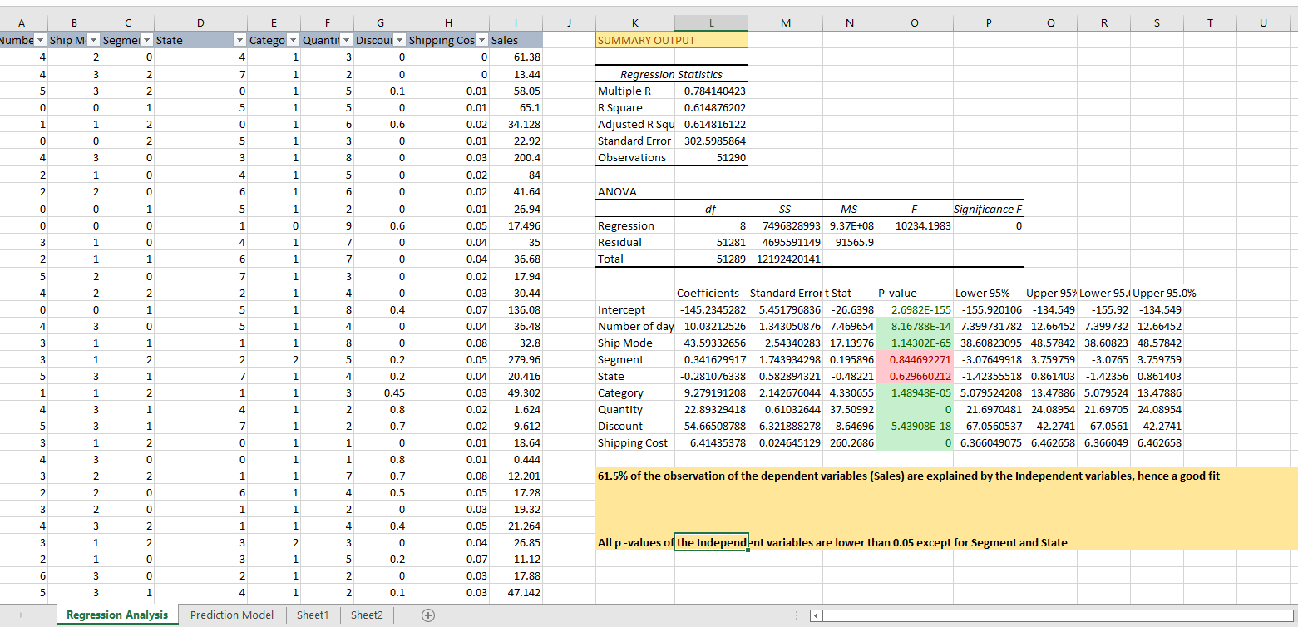
Business Question -1 Multiple Linear Regression Model

Slide 42
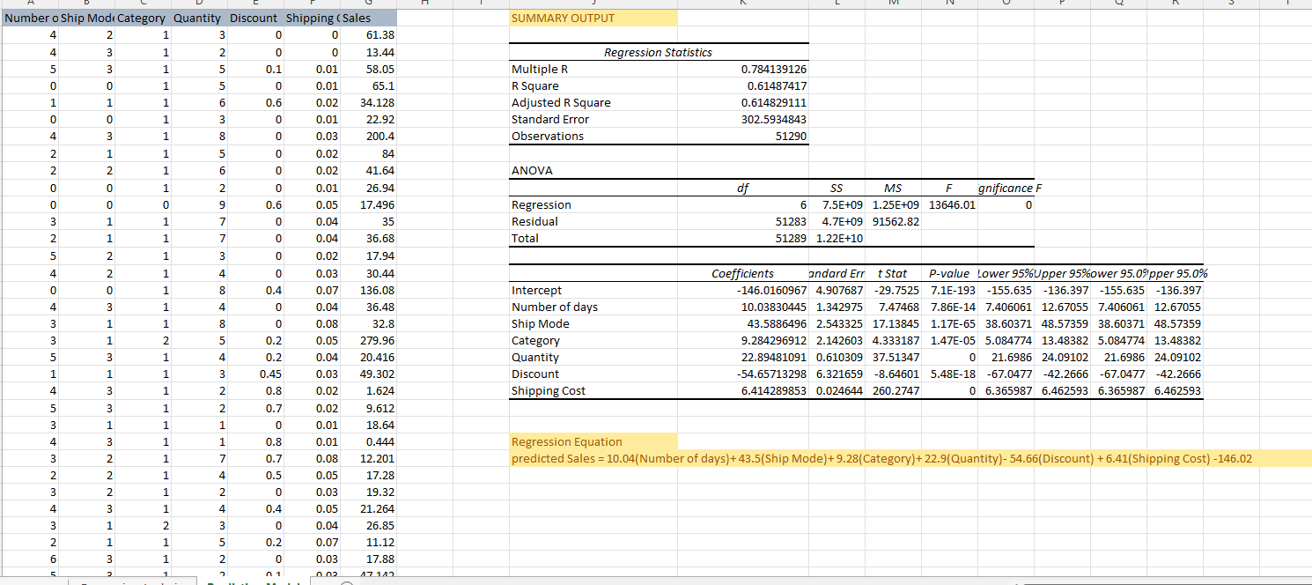
Business Question 1- Regression Analysis

Slide 43
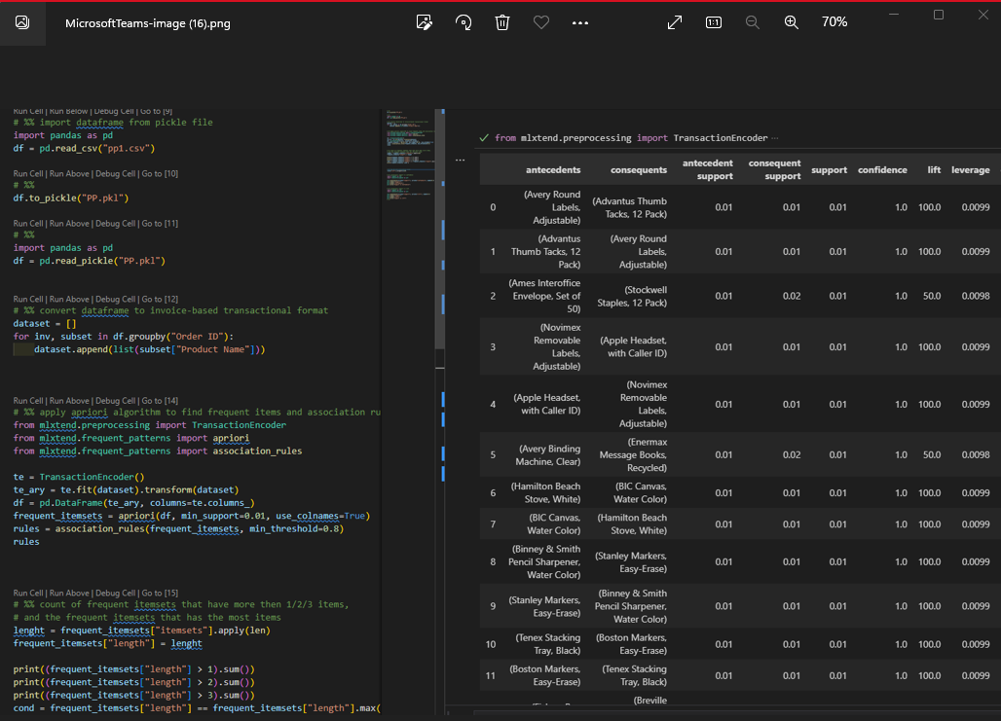
Association Mining

Slide 44
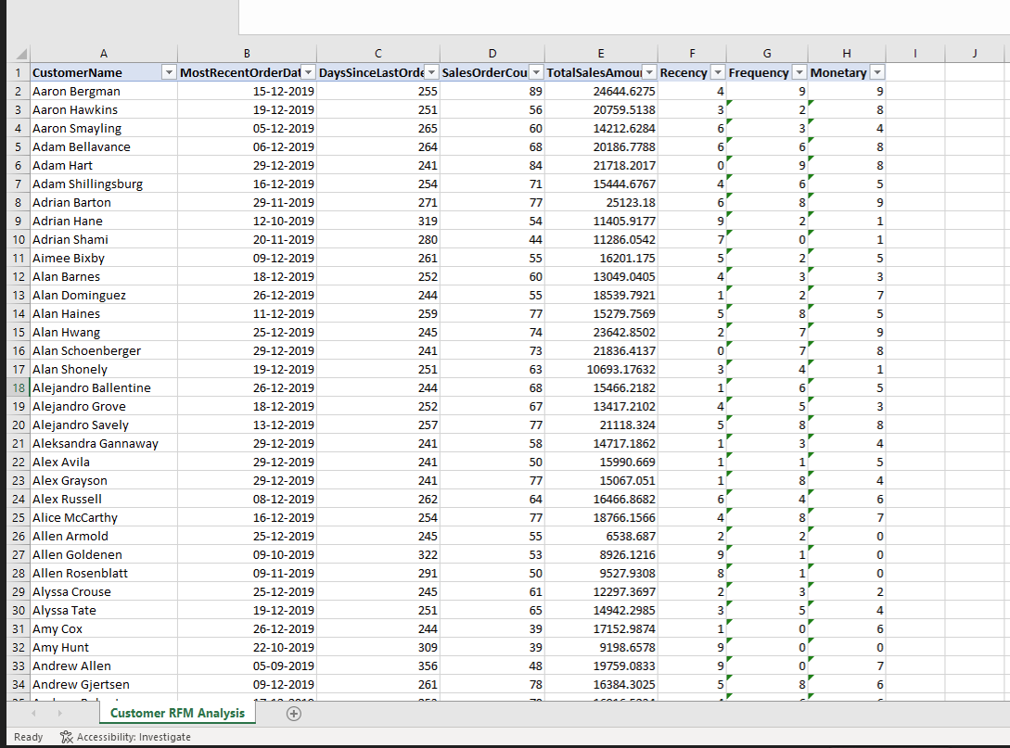
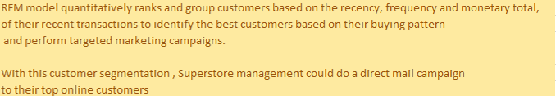
RFM Model (Customer Segmentation)

Slide 45
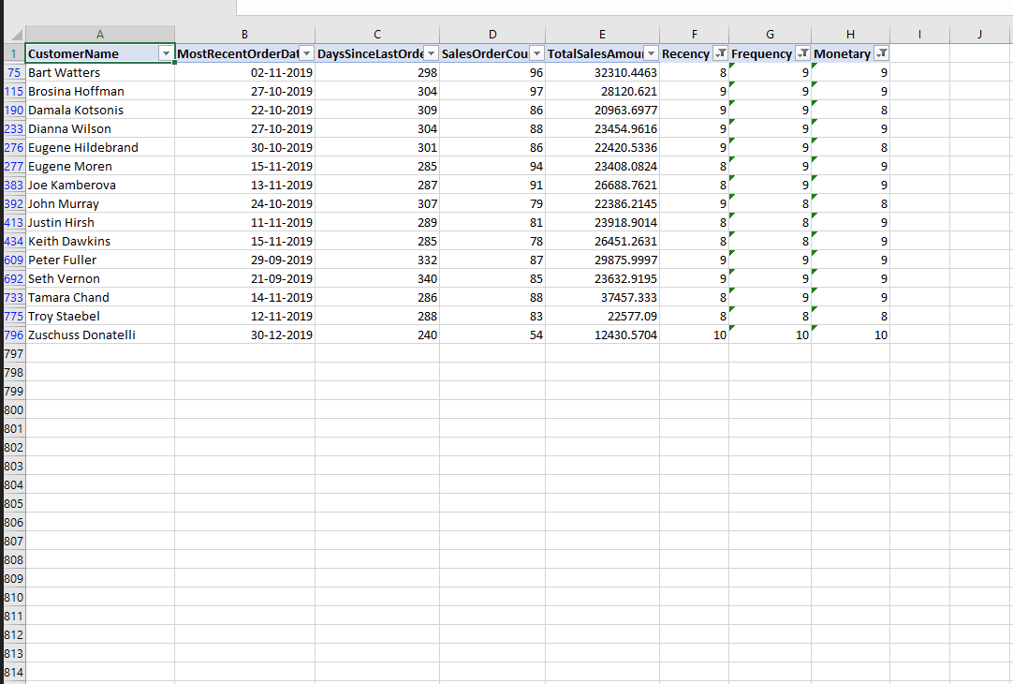
Customer Segmentation

Slide 46
Summary of Analysis
The segment and state variables were not correlated with the Sales performance. At such we recommend that the Superstore Management should focus on existing variables like the Number of days for shipping, Ship Mode, Category, Quantity, shipping cost and discount for increased sales performance.
Based on apriori algorithm on figure above: 1. On the first rule when someone order Avery Round labels Adjustable they will order Advantus Thumb Tacks 12packs too, with 0.01 support levels. In this rule Advantus Thumb Tacks 12packs will bought by customers if they bought Avery Round labels Adjustable and the probability is 100%.

Slide 47
Summary of Analysis
RFM model quantitatively ranks, and group customers based on the recency, frequency and monetary total, of their recent transactions to identify the best customers based on their buying pattern and perform targeted marketing campaigns. From the customer segmentation, we have only 15 customers from 795 customer records that are top online shoppers. Approximately 2% of customers rank 8 or higher on each of the RFM scores. We recommend that Superstore management could do a direct mail campaign to these group of customers.

Slide 48
Recommendations
From the analysis, some insightful results about profit and loss can be drawn. Superstore can improve profit and sales by the following measures;
- Discontinue the loss-making products for impacted stores
- Minimize discount on loss making products. Hence, the discount policy needs to be reviewed.
- Bundle the loss-making products with other high profit products to spread the cost across the segments/ category/ subcategory.
- Better shipping mode strategies
Targeted marketing can be made to the top 15 customers highlighted from the RFM model
Product recommendations based on frequent and associated items that were bought together

Slide 49
Conclusions
At the end of this analysis, it is discovered that technology category had higher sales and profits with the most sales and profit in 2019 and the most profitable city as Winnipeg in the Western region of Canada. Notably, tables in the furniture category recorded higher losses. In addition, discounts, shipping costs, shipping mode, quantity bought and number of days to ship impact sales performance. Therefore, Superstore needs to streamline their discount policy. The forecast analysis shows increase in sales and profit for the next 3 years (2020-2022) with the assumptions that there were no external factors like inflation, the COVID-19 pandemic and the Russia-Ukraine war.

